Slide 1



|--- BRTS PORTAL ---|
Prepared By:-
Name : Vyom Kalariya
Roll no: 158
Enrollment No: 23002171410024
Batch: A4
Branch : CS & IT

Slide 2

INTRODUCTION
Database Connectivity: Establishes a connection to a MySQL database and creates tables for bus routes.
Bus Management: Initializes and manages multiple bus threads, each representing a bus moving through predefined stops.
User Management: Allows users to sign up, log in, and interact with the system. Users' details are stored in the database.
Interactive Menu: Provides a console-based menu for users to check bus locations, view routes, and book tickets.
Location Updates: Continuously updates and displays the current location of buses using a separate thread.

Slide 3
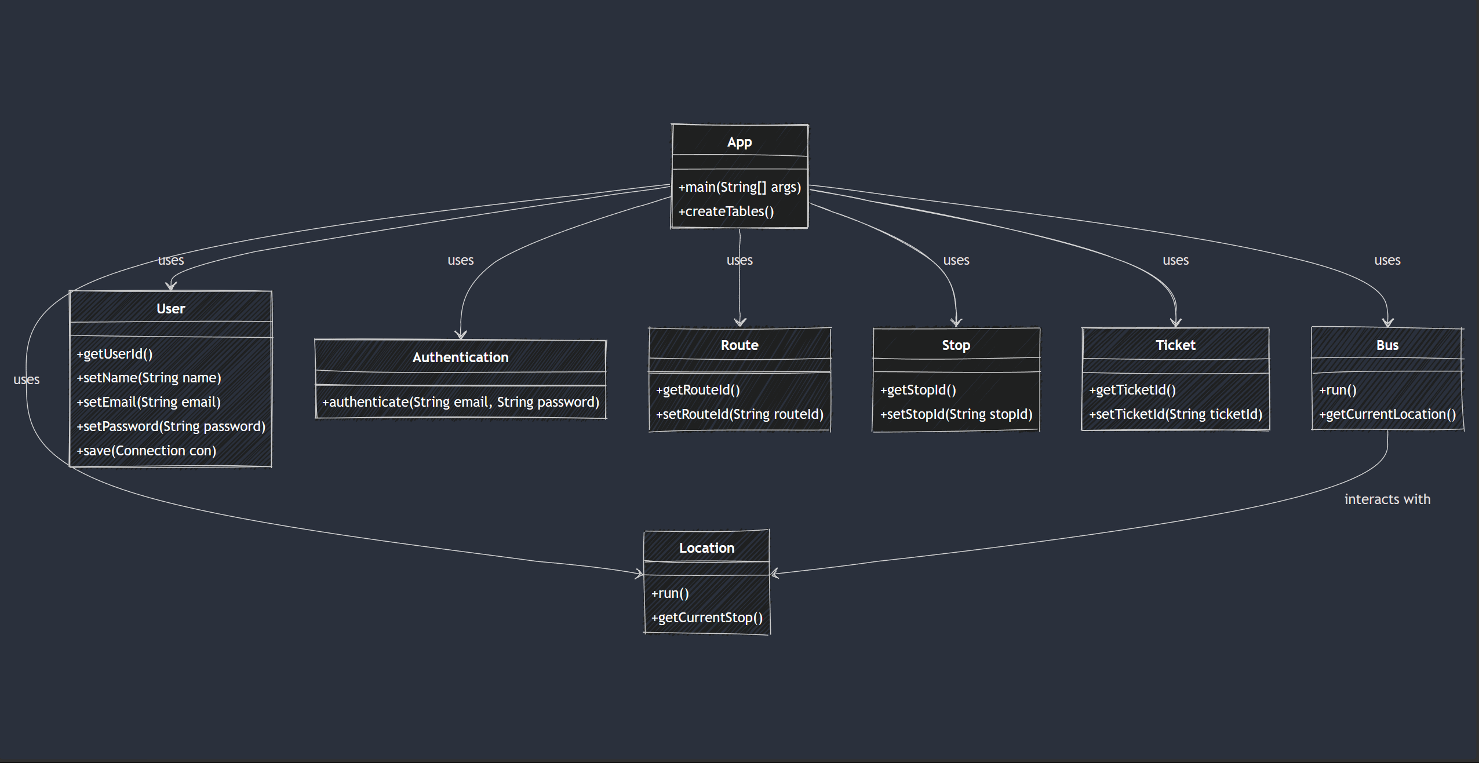
Flow chart

Slide 4
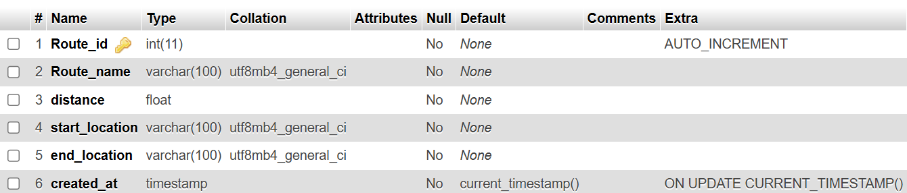
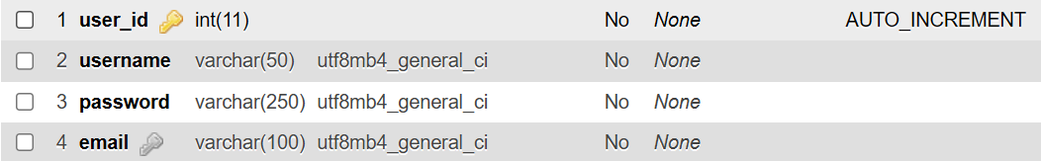
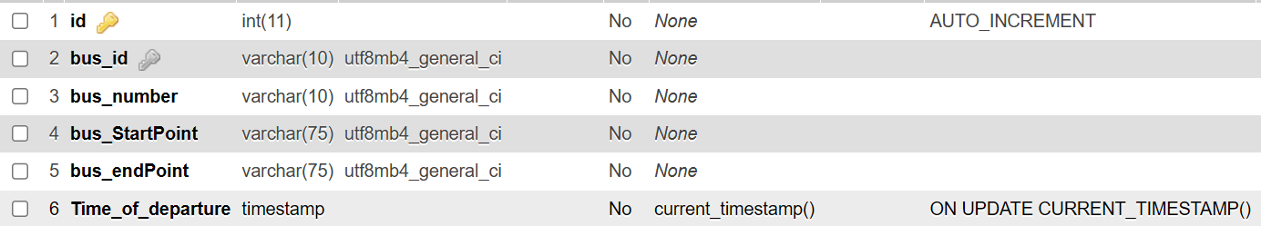
Flow schema

Slide 5
Functionalities of project Related with Particular Subject
Data Structures using JAVA | JAVA - II | DATABASE MANAGEMENT
LinkedList (Bus) (Bus ID ) | Exceptional Handling (Login without error) | CREATE OR REPLACE TABLE ALL STOP NAME ARE PRE DEFINED By SQL
HashMap (Save User data) (route infomation) | JDBC (manage database ) | ADD USER (Name/ID/Email/Password)
List (Stop name/ID/route name) | Collection ( for code efficiency ) | DDL QUERY ( CREATE / ALTER )
 | Virtual bus work in code Give real time bus info And real time bus experience | DML QUERY (INSERT / UPDATE / SELECT )

Slide 6
-Explaination-
THERE’s Virtual bus so we get run time info on each bus
USER CAN SIGN IN / LOG IN
USER CAN’T ACCESS FULL FUNCTION UNTIL HE LOGIN (LIKE REAL BRTS APP)
USER CAN BOOK TICKET (START TO END)
USER CAN CHEAK WHERE BUS IS RIGHT NOW
USER CAN CHEAK HOW MANY STOPS ARE THERE

Slide 7
-THANK YOU-
FOR WATCHING THIS TO THE END
BRTS PORTAL

